Slide 1
PROJECT TITLE: SMART BLIND STICK COURSE NO: CSE 3104 COURSE TITLE: PERIPHERALS AND INTERFACING LABORATORY
Submitted To:
Mohammad Insanur Rahman Shuvo
Assistant Professor
2. Md. Motaleb Hossen Manik
Lecturer
Submitted by:
Subah Nawar
Roll no: 1807006
2. Shaikh Prothomaa Binte Minhaz
Roll no: 1807010
3. Sazia Akhter Tushi
Roll no: 1807026

Slide 2
Objectives

Slide 3
The main objectives of this project are:-
The main objective of our project is to build a smart stick for blinds so that they can walk more independently and comfortably.
To implement the project in such a way so that it can detect obstacles at certain range, holes, water obstacles, fire and react accordingly i.e. vibration motor, buzzer, LED etc.
To help blind men to send emergency message

Slide 4
Design Process
What do we want to do with this smart blind stick?

Slide 5
Design Process (cont’d)
Control buzzer and vibration while detecting obstacle at a certain distance using multiple sonars
Detect holes and turn buzzer on
Detect water obstacle and vibrate
Detect fire and turn buzzer and vibration motor on
Control the LED so that people nearby don’t accidently collide with blind men by detecting darkness through LDR
Being able to send message to people remotely by GSM module

Slide 6
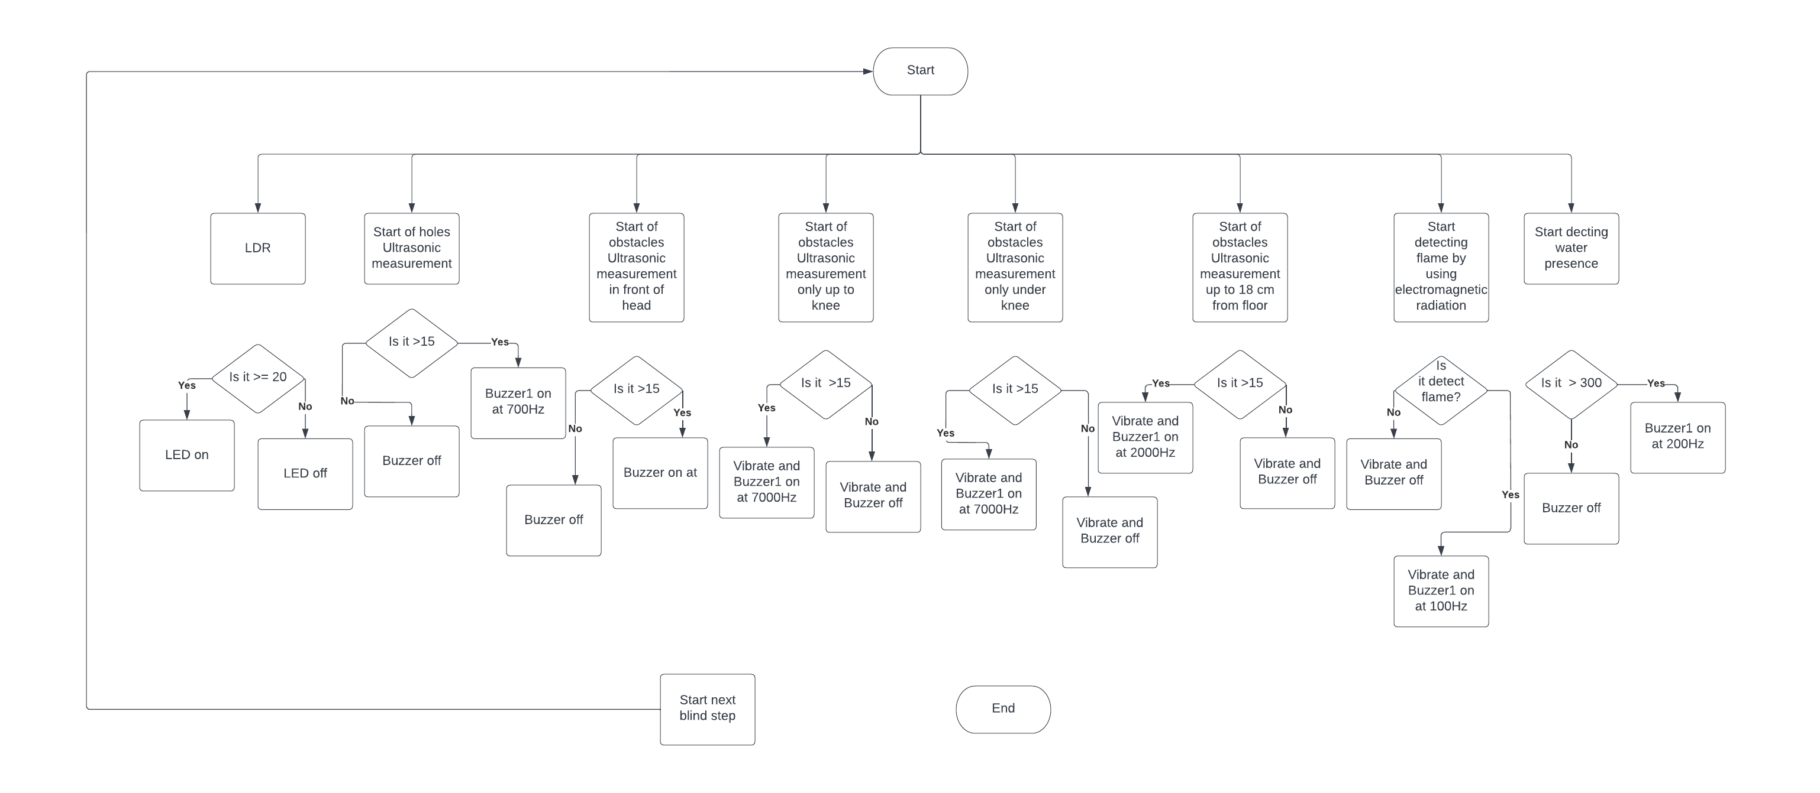
Flow Chart
<

Slide 7
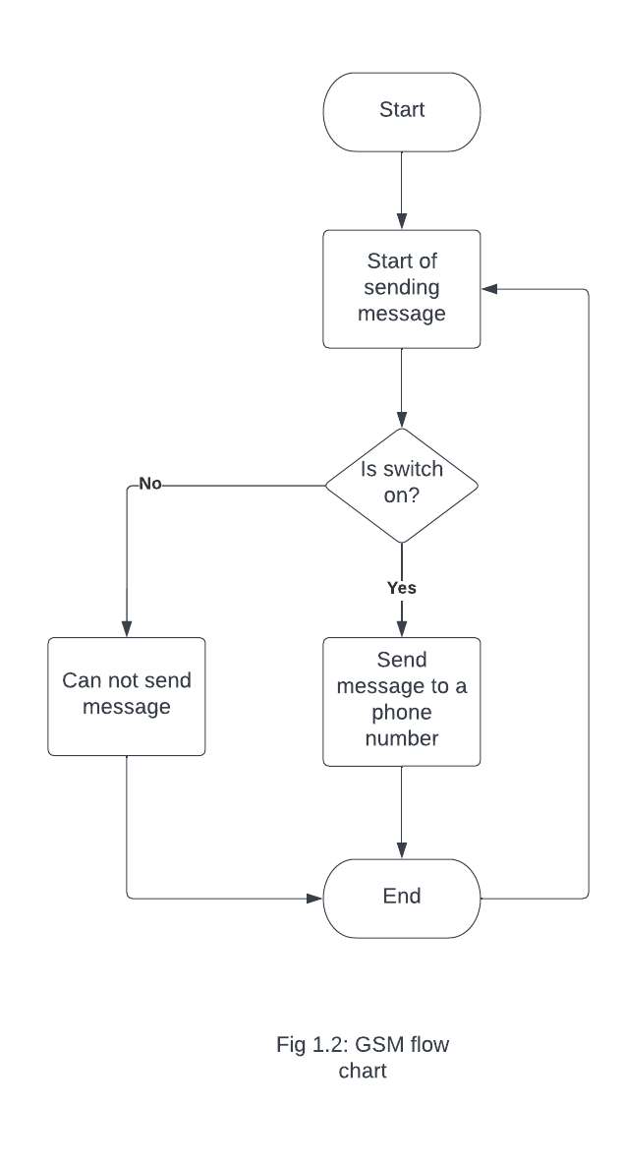
Flow Chart

Slide 8
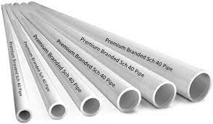
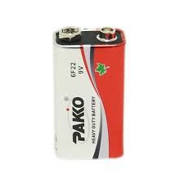
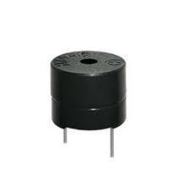
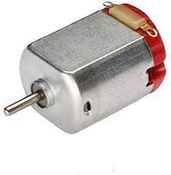
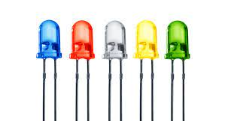
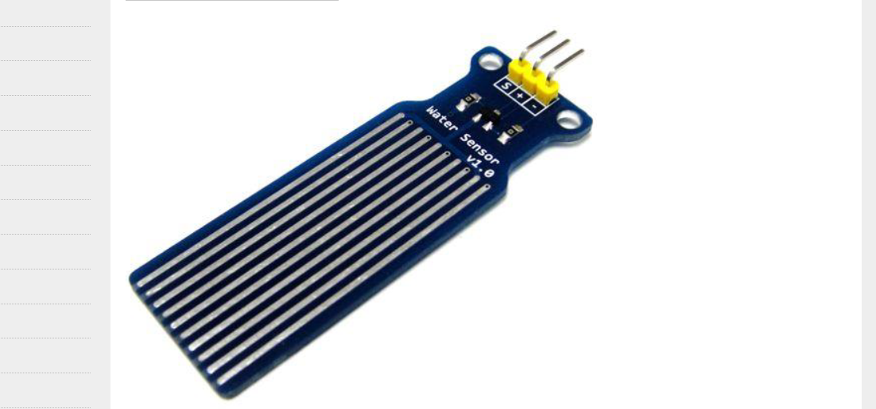
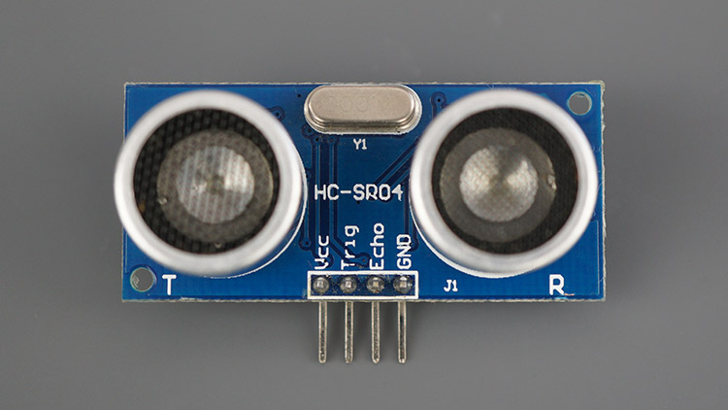
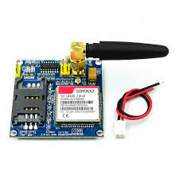

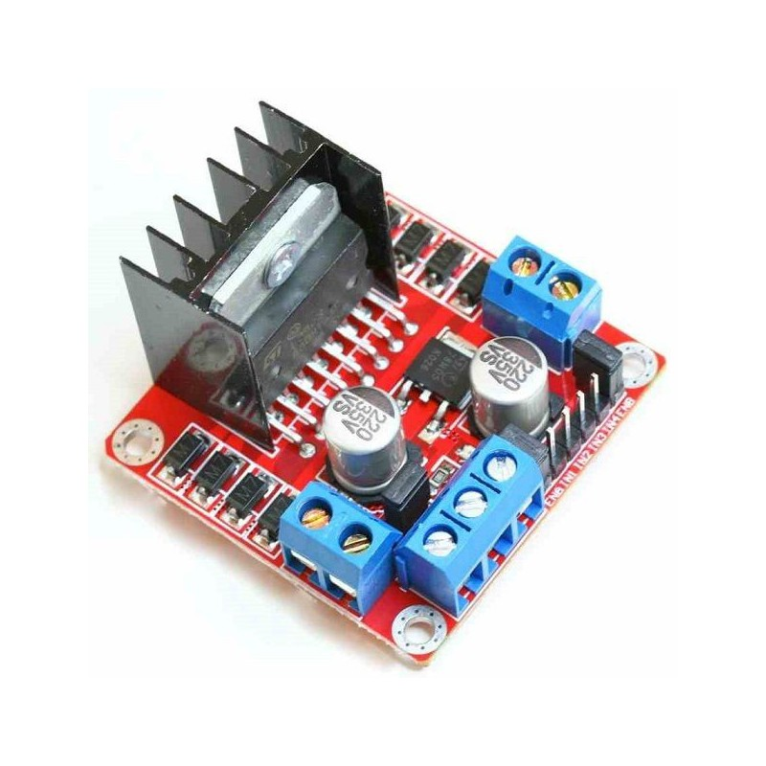
Required Components:
Main Equipment
1.Arduino Uno 2. Sonar 3. Vibration motor 4. 9v battery 5. Buzzer 6. Led diode
7. Fire detector 8. Water sensor 9. Jumper wire
10. GSM module
11. LDR
For Structure
1. PVC pipe
2.PVC Board
3. Anti Cutter
4. Super Glue
5. Scissors

Slide 9
Working Of Smart Blind stick

Slide 10
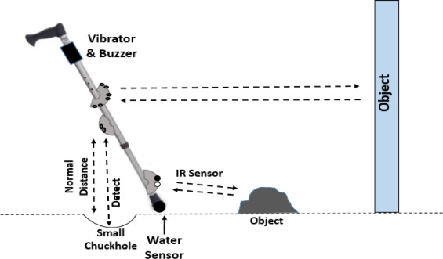
LDR
Blue
Is the colour of the clear sky and the deep sea. It is located between violet and green on the optical spectrum.
Fire sensor

Slide 11
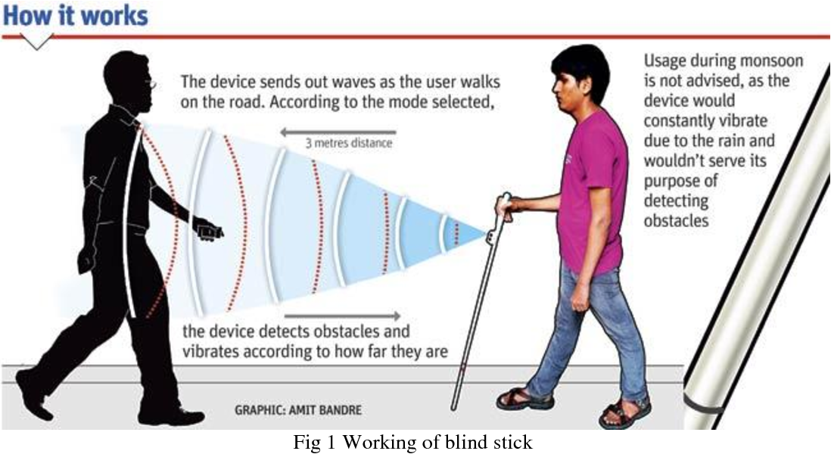

Slide 12
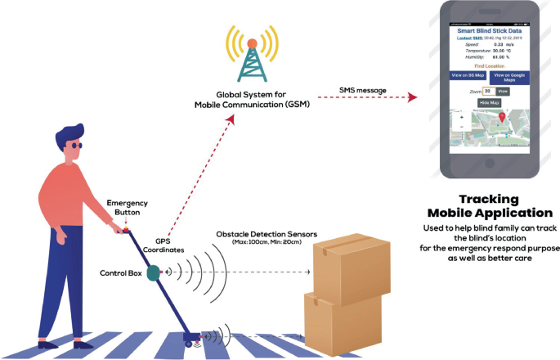
Help I’m in danger
When Button in the handle is pressed
Send Message to a person through GSM

Slide 13
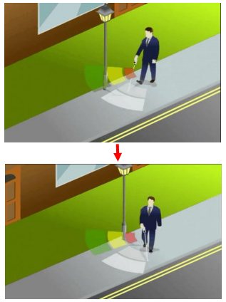
Sensor model: Sonar Sensor (HC-SR04)
Smart blind stick is a device for visually impaired to guide the user to respective destination and avoiding to collide with the obstacles. It will use ultrasonic sensor HCSR04 to detect the obstacles. Along that it will use Arduino as the main controller. It will also have a buzzer and a motor. Whenever there is any obstacle in its range i.e less than 60cm, the sensor will detect the distance from the obstacle and send it to the controller.

Slide 14
MOTOR
The coin type motor can be built with a case, bearing, rotor, shaft, magnet, bracket, FPC, counterweight, brush, coil assembly, lead wire, & adhesive UV. The commutation points get in touch with brushes end. It will strengthen the coils within the rotor. Stimulating the coils generates a magnetic field & it is well-built to cooperate with the ring magnet incorporated into the stator to cause rotation.

Slide 15
Buzzer model: AUD 00002
Electromagnetic buzzer is composed of oscillator, solenoid coil, magnet, vibration diaphragm, housing, etc. When the power supply is switched on, the audio signal current generated by the oscillator passes through the solenoid coil, which generates a magnetic field. The vibration diaphragm periodically vibrates and sounds under the interaction of the solenoid coil and the magnet. The frequency of the general electromagnetic buzzer is 2-4 kHz.

Slide 16
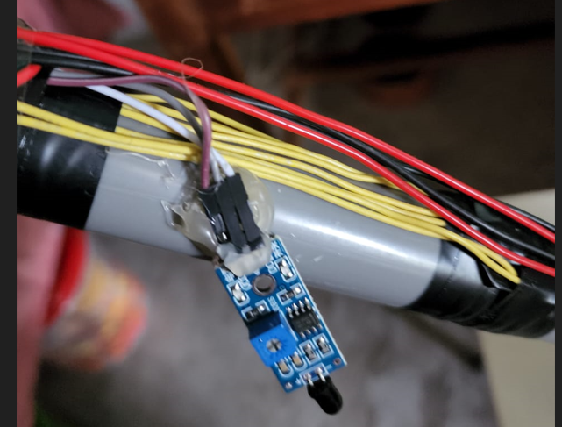
Fire sensor model:sen00243
A fire detector works by detecting smoke and/or heat. These devices respond to the presence of smoke or extremely high temperatures that are present with a fire. After the device has been activated, it will send a signal to the alarm system to perform the programmed response for that zone.

Slide 17
Water Sensor v1.0
Connecting a water sensor to an Arduino is a great way to detect a leak, spill, flood, rain, etc. It can be used to detect the presence, the level, the volume and/or the absence of water. While this could be used to remind you to water your plants, there is a better Grove sensor for that. The sensor has an array of exposed traces, which read LOW when water is detected.
Here, we will connect the water sensor to Digital Pin 8 on Arduino, and will enlist the very handy LED to help identify when the water sensor comes into contact with a source of water

Slide 18
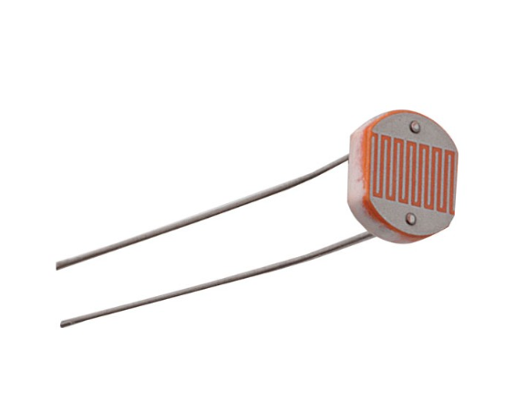
N5AC501085 LDR
LDRs (light-dependent resistors) are used to detect light levels, for example, in automatic security lights. Their resistance decreases as the light intensity increases:
in the dark and at low light levels, the resistance of an LDR is high and little current can flow through it
in bright light, the resistance of an LDR is low and more current can flow through it.

Slide 19
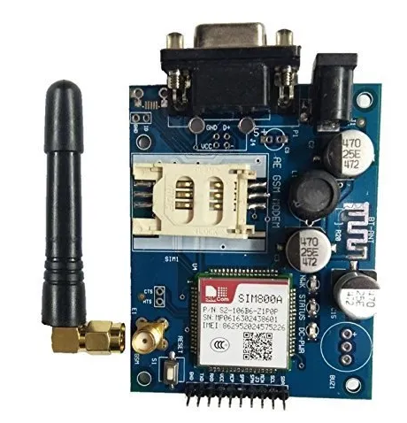
A customized Global System for Mobile communication (GSM)
A GSM modem or GSM module is a device that uses GSM mobile telephone technology to provide a wireless data link to a network. GSM modems are used in mobile telephones and other equipment that communicates with mobile telephone networks. They use SIMs to identify their device to the network..

Slide 20
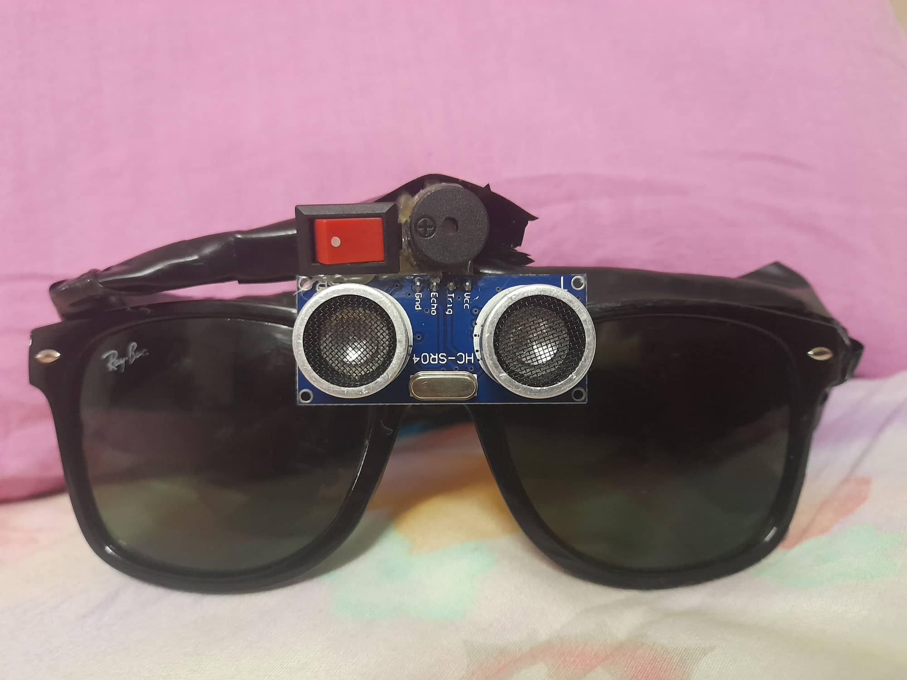
Sunglass for blind man
A sunglass that helps a blind person to detect a branch of tree appeared in front of him .we added this to our project so that it can alarm our user about obstacles in front of his head.

Slide 21
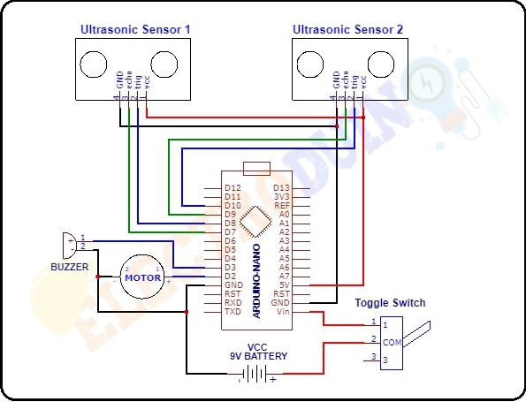
Schematic diagram that was used as Reference

Slide 22
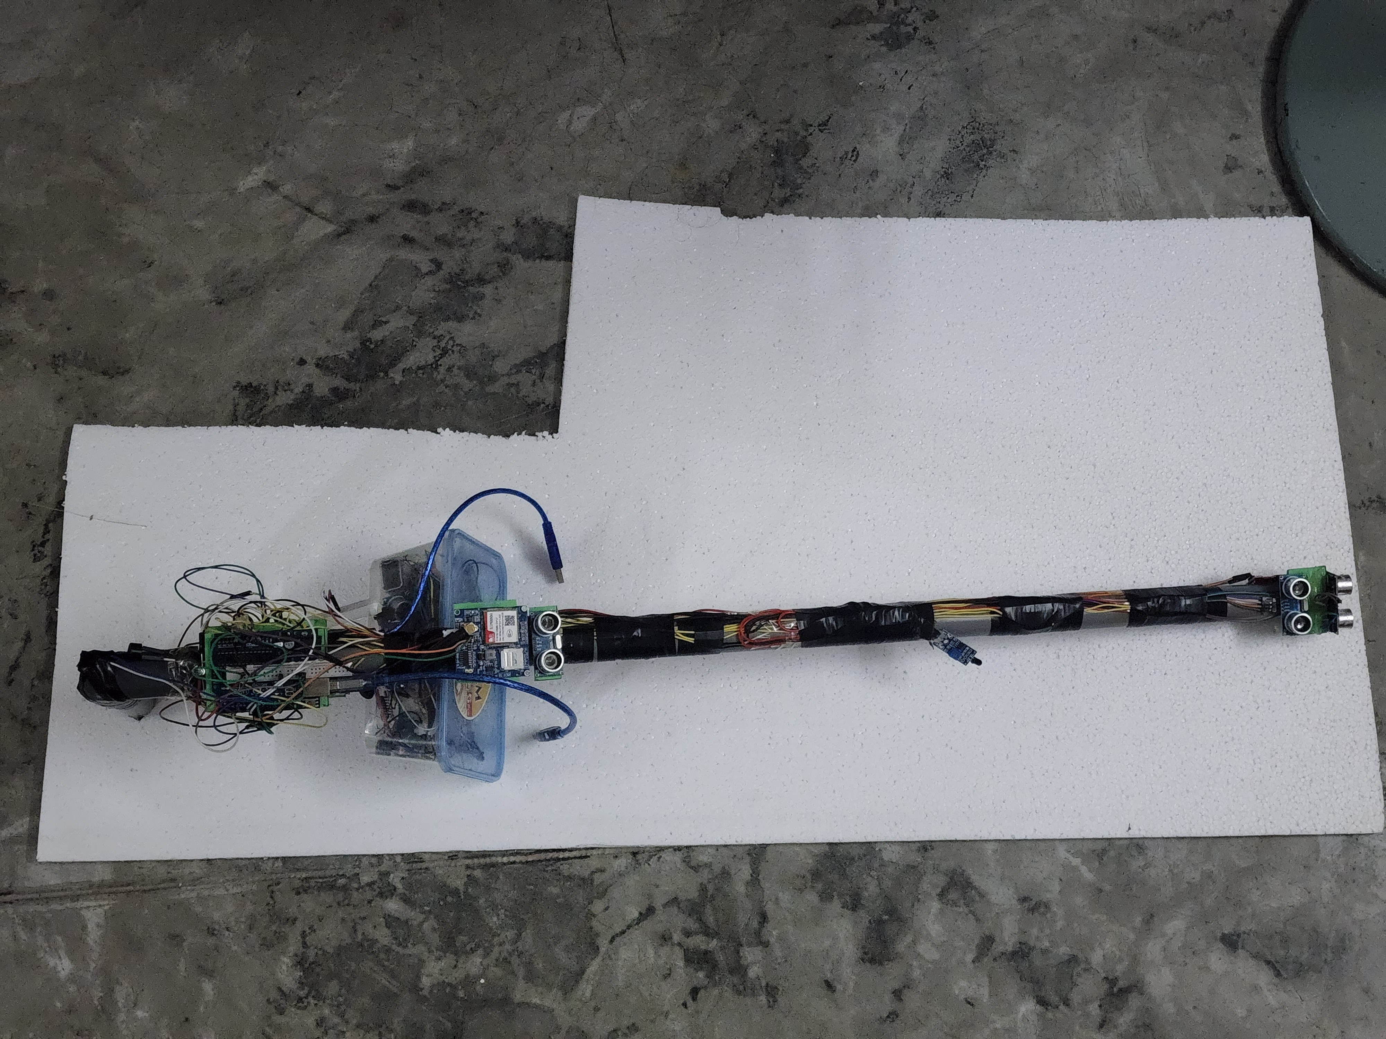
Figure of Complete Project

Slide 23
Project description
This is a project of a Smart Stick For Blind Peoples.
In this Smart stick there are sensors which senses the obstacles or walls from 15cm range then
this stick vibrates & makes buzz sound. Another sonar used under the stick to detect
Any holes/ditches in 15 cm range. This is all done by sonar. Thus, this Smart Stick warns the blind person that there is an obstacle or wall in-front of him/her. Then that person will be warned from obstacle or wall.
Fire detector is used to detect fire and then vibration motor and buzzer will work simultaneously.
Frequency of sound(different from other buzzer) is used so that blind man easily detect that it’s an alarm for fire. As blind men are have very sharp sense of hearing they easily differentiate the differences in such sounds and can act accordingly.

Slide 24
Project description
Water sensor is designed for water detection, which can be widely used in sensing rainfall, water pits and even liquid leakage.
LDR that detect bleak and make a led turn on so that anyone around blind men can realize his existence.
A sunglass is added to our project to detect any obstacle just in front of his face(like tree branch).
Finally We have added GSM module so that blind men can send emergency message when necessary
Thus, this is the overall description of functionality of our project

Slide 25
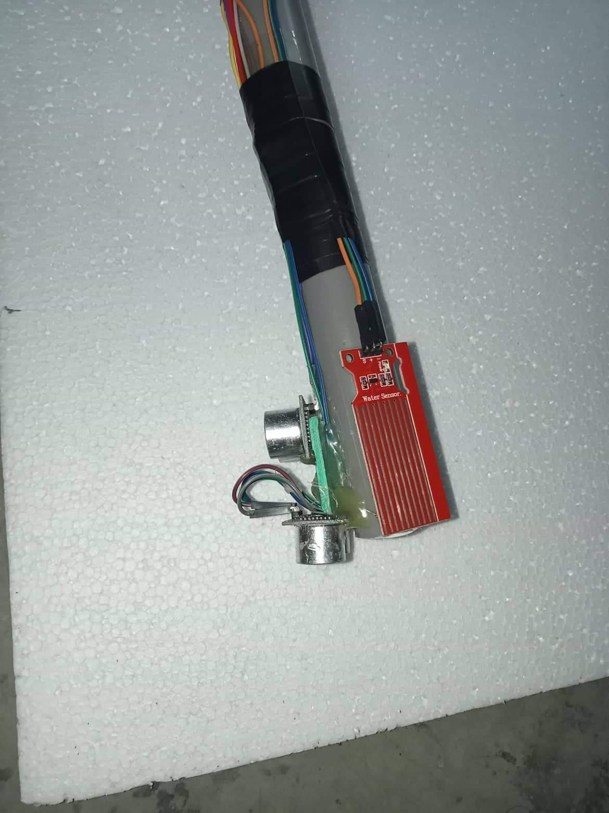
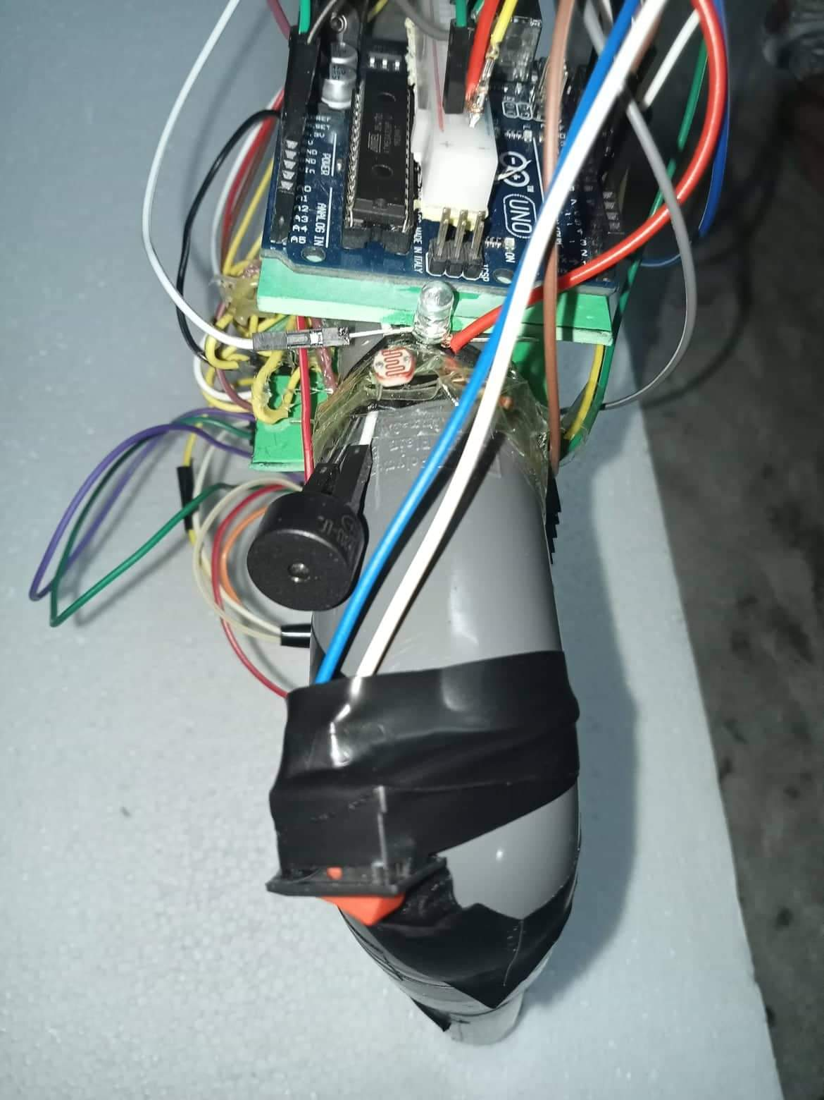
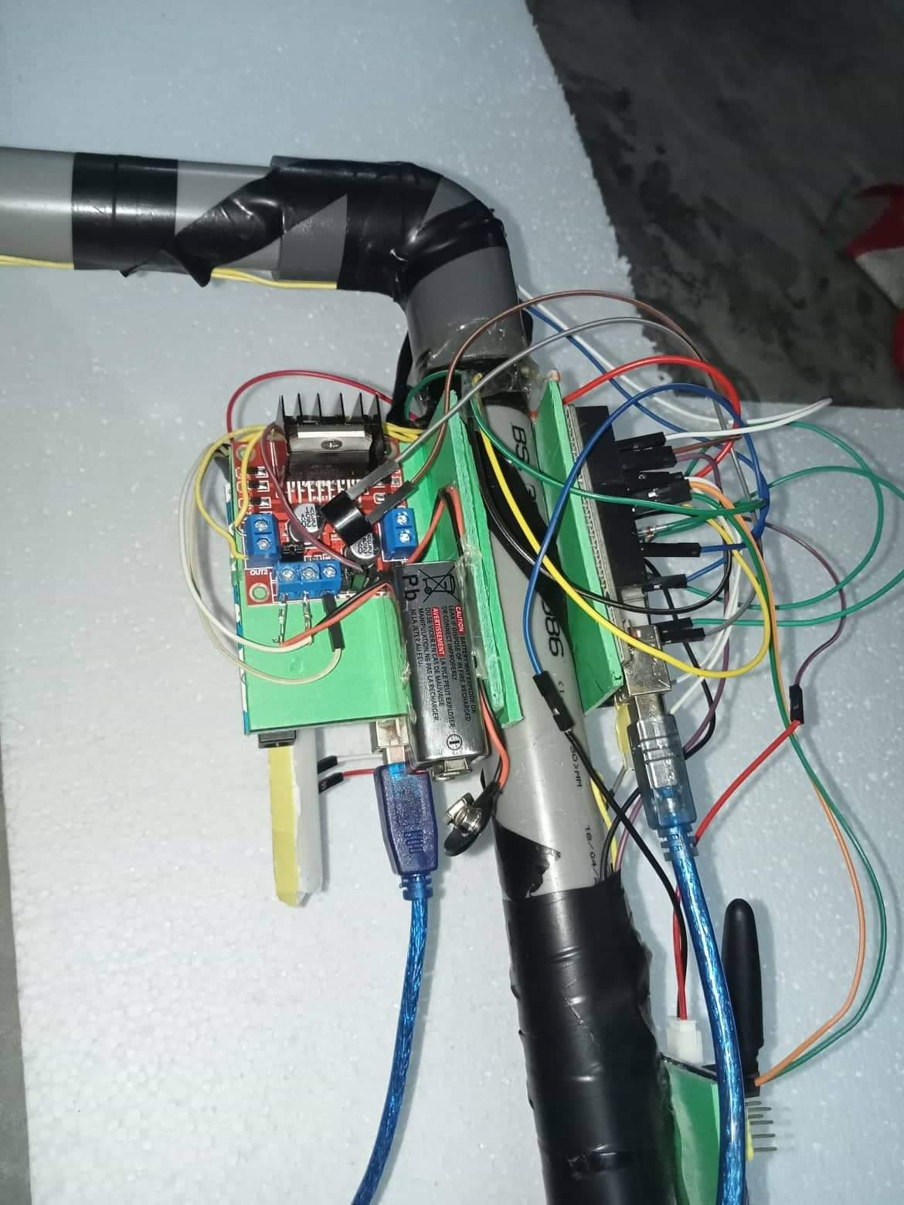
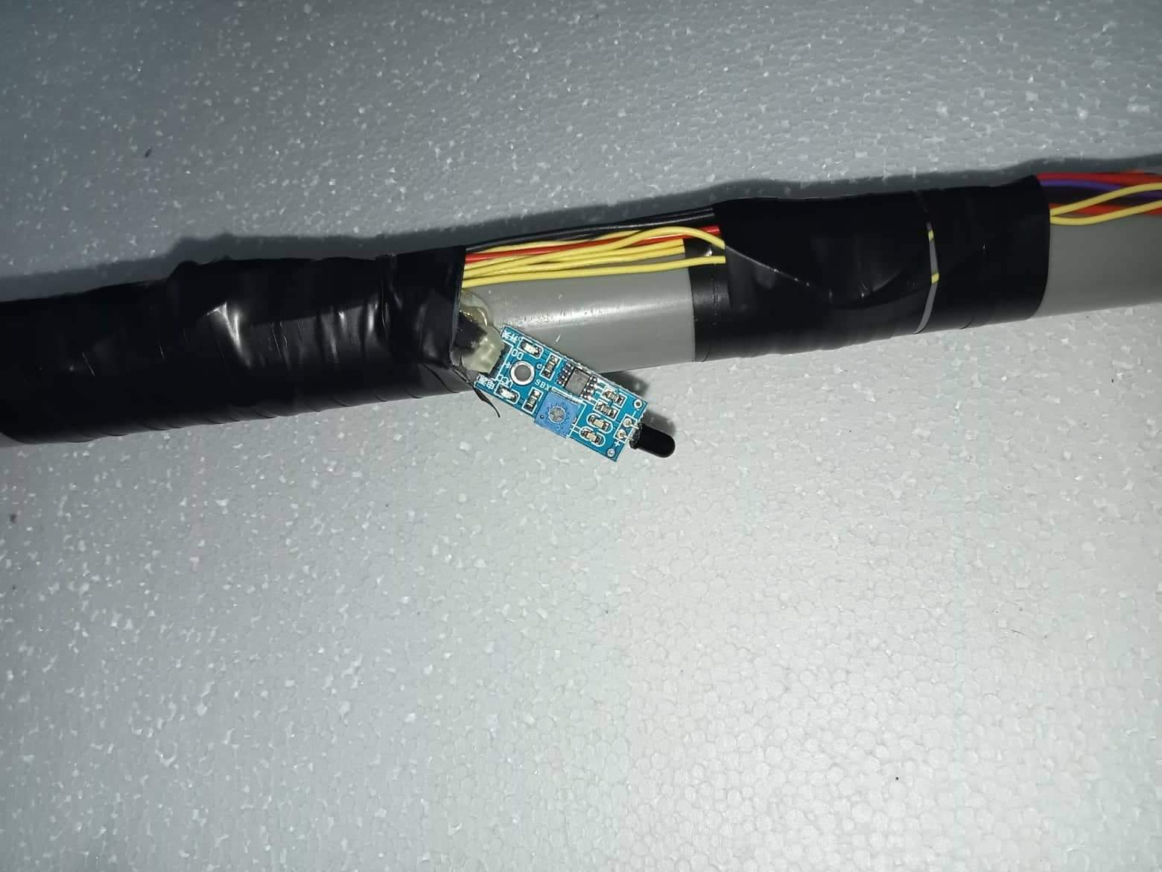
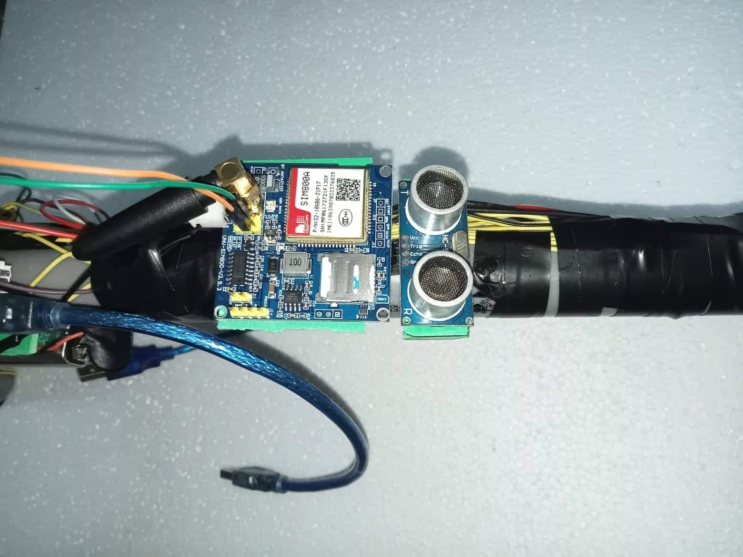
Project description
Fig: Photos of different parts of the project

Slide 26
Video Demo
https://drive.google.com/drive/folders/1ZEDme4u4hKnWYSbA_ySjlXmsTaLjUp5O?usp=sharing

Slide 27
References:
https://create.arduino.cc/projecthub/24Ishan/fire-sensor-4ad4de
https://create.arduino.cc/projecthub/NewMC/water-level-monitor-b42be9?ref=search&ref_id=water%20sensor&offset=2
https://www.youtube.com/watch?v=_RpSaj9j-GY
https://www.makeuseof.com/tag/getting-started-with-arduino-a-beginners-guide/

Slide 28
Thank You

